Slide 1


TruScore Grading (TSG)
AI-Powered Sports Card Pre-Grading
Building trust, one scan at a time.
Investor Pitch Deck - Pre-Seed Round

Slide 2

The Problem
- Professional grading is expensive, slow, and opaque.
- Collectors waste money submitting cards that are not worth grading.
- Human graders are inconsistent, biased, and non-transparent.
- PSA's acquisition of SGC and Beckett risks monopolizing grading standards.

Slide 3
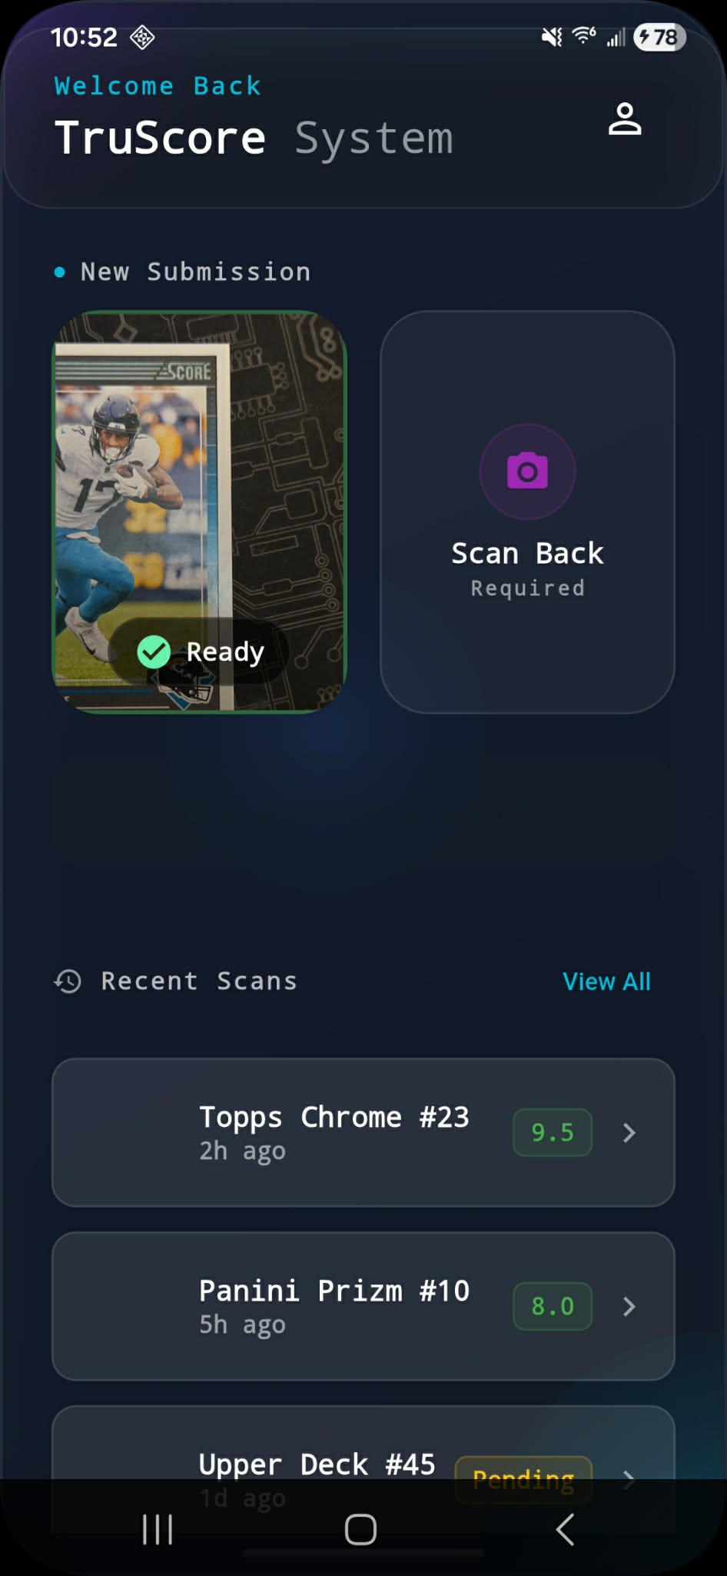
The Solution
- AI-driven pre-grading app for collectors.
- Analyzes card condition using smartphone scans.
- Delivers objective, explainable grade estimates.
- Highlights defects: corners, edges, surface, centering.
- Shows whether grading is financially worthwhile using real-time market data.

Slide 4

Why Now
- Card market is a multi-billion dollar ecosystem.
- Grading volumes are booming and frustration is rising.
- No scalable, AI-first consumer tool exists.
- Consolidation is increasing control and bias in grading.
- Collectors demand transparency, consistency, and control.
$ billions
Growing market
Rising
Demand for trust
Wide open
AI opportunity

Slide 5

Target Market
Hobbyists
Flippers
Investors
Collectors who scan and grade frequently.
Fast repeat users who need ROI clarity.
Portfolio owners seeking objective grades.

Slide 6
Product Overview
- Easy smartphone scan.
- Transparent AI grading logic.
- Unlimited scans on subscription ($5-$10/mo).
- Clean UX with collector-first features.

Slide 7

Key Differentiators
Objective AI
Visual Explanations
Built for Users
Not human opinion.
See why grades change.
Not grading companies.
Subscription Model
Scales Across Types
No per-card fees.
All major card categories.

Slide 8
Technology
- Computer vision and ML models trained on large datasets.
- Defect detection pipeline (corners, edges, surface).
- Real-time market value estimation.
- Scalable cloud-based backend.
- Continuous improvement via user scans.
Scan
Detect
Score
Explain

Slide 9

Current Status
- Core AI pipeline built.
- Dataset and training infrastructure complete.
- Desktop tools functional.
- Mobile app in active development.
- Seeking funding to complete mobile MVP and scale.

Slide 10
Traction & Roadmap
Today
Functional AI, live dataset tools
Next 6 Months
Complete mobile app, begin go-to-market
12 Months
Paid user growth, analytics, partnerships

Slide 11
Business Model
- SaaS subscription with unlimited scans.
- Upsells: bulk scanning, analytics, pro tools.
- Low churn driven by repeat collector usage.
$5-$10
per month

Slide 12
Competitive Landscape
Company | Model | Bias-Free? | Explainable?
PSA / SGC / Beckett | Full Grading | No | No
Manual Pre-Grading | Freelance | No | No
TruScore Grading | AI Pre-Grading | Yes | Yes

Slide 13

Vision
To become the standard pre-grading platform for collectors, promoting trust, transparency, and data-driven confidence.

Slide 14
The Ask
$50,000 Pre-Seed Investment
- Finalizing mobile MVP.
- Infrastructure and cloud costs.
- Marketing and go-to-market launch.
- Scaling and tuning AI models.

Slide 15

Why This Is a Smart Bet
- Built for a massive, underserved market.
- Already functioning AI pipeline.
- Strategic timing: consolidation drives collector distrust.
- Founder-led, passion-driven, data-backed execution.
- $50K unlocks launch and early user growth.

Slide 16

TruScore Grading (TSG)
Pre-grading built on trust, not guesswork.
https://deweydbdecibel.github.io/truscoregrading

